Slide 1
SAFE TOUCH
The newest and safest wrist band dispenser

Slide 2
01
02
Table of Contents
03
04
The company
The market
The product
The staff

Slide 3
01
THE COMPANY

Slide 4


MISSION AND VISION
Our mission
Our vision
As a company we seek international coverage, as well as constant innovation in order to provide portability and fashion, avoiding infections on every day's routine.
To facilitate and to make the "new normal" fashionable, always offering innovation and functionality within reach.

Slide 5




VALUES
Responsibility
Quality
Safety
Protection & trust
Originality

Slide 6
OUR OBJECTIVE
To be the leading company in the hygiene market
To be recognized for our variety of designs, comfort, and for providing the highest security to our customers in every step of their lives in the following five years.

Slide 7
OUR NAME
Safe
Touch
It is not only a name, but also a feeling. A feeling of safety and protection just one click away.
It means style, fashion, trend.
It is the perfect representation that fashion is not at odds with health.

Slide 8
02
THE MARKET

Slide 9
We aim to make every day EASIER, more FASHIONABLE and SAFER at the reach of our wrist.

Slide 10
MARKET SIZE
01
Who?
Woman from 20 to 50 years old.
02
Where?
Who live in big cities (ZMG).
Characteristics?
03
Who live in a hurry, worry about the hygiene, but love fashion,
04
Economic level?
A/B, C+, C

Slide 11
MARKET SIZE CALCULATION
Penetration
16.96%
Online sales of Women in Mexico: 10.6%
Growth of online sales in Mexico in 2020: 60%
5´178,864 people x 22.8% x 49% = 578,582.686 women in ZMG
578,582.686 * 16.96% =
98,128 women
Woman
Within our age gap.
SEL
Socioeconomic Level based on AMAI
ZMG
5’178,864 people

Slide 12
03
THE PRODUCT

Slide 13
VALUE PROPOSAL
To analyze in a better perspective the value of our product we made a survey to see if we will be satisfying a necessity in our market.
Therefore we found out that people are indeed interested in Safe Touch and it is something that they would buy. This analysis gives us a better outlook on how this product will be working once it is out on the market, based on consumer preferences.
Safe touch not only provides safety right now in the pandemic, it offers comfort, fashion and a new way of doing things, in this new normal day routine. By having hand sanitizer more accessible to use while being out, the times you clean your hands will increase, providing safety to you and those around you.

Slide 14




INSIGHTS
The fashion industry is a very challenging, and competitive industry. In order to survive, brands must find ways to innovate in their products
“The futuristic attitude is part of the five outstanding trends in the year 2022”. Synthetic materials are associated with futuristic effects, that is why our product is elaborated with synthetic materials
Functionality becomes an added value that gives competitive advantages in the world of fashion.
Since the tendency to use the antibacterial gel will increase, it will indirectly favor the need for a device to store it.

Slide 15
The hand sanitizer market will have a compound annual growth rate of 3.52% over the estimated period (2020-2025).

Slide 16
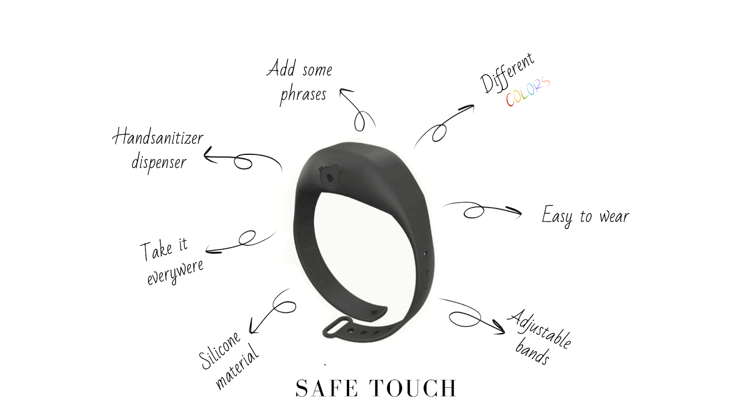
PROTOTYPE

Slide 17
Differentiation strategy:
Neutral prices
PRICE STRATEGY

Slide 18
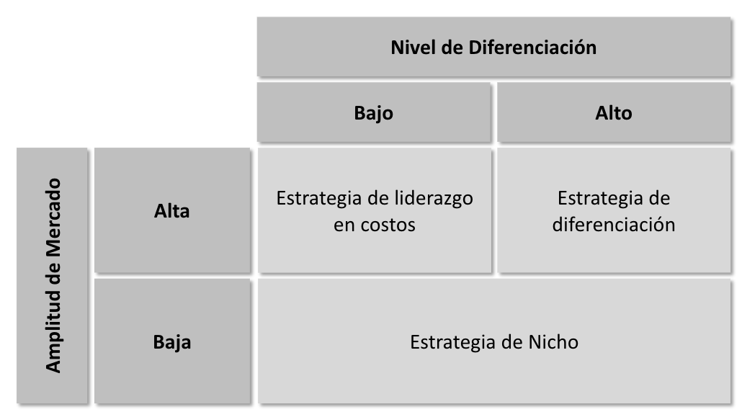
PRICE STRATEGY
Notes:
Since our product finds itself within a high level of differentiation and immerse in a market that’s growing fast and with a lot of competition, meaning high amplitude, we find that the competitive advantage to set initial price is differentiation strategy.

Slide 19
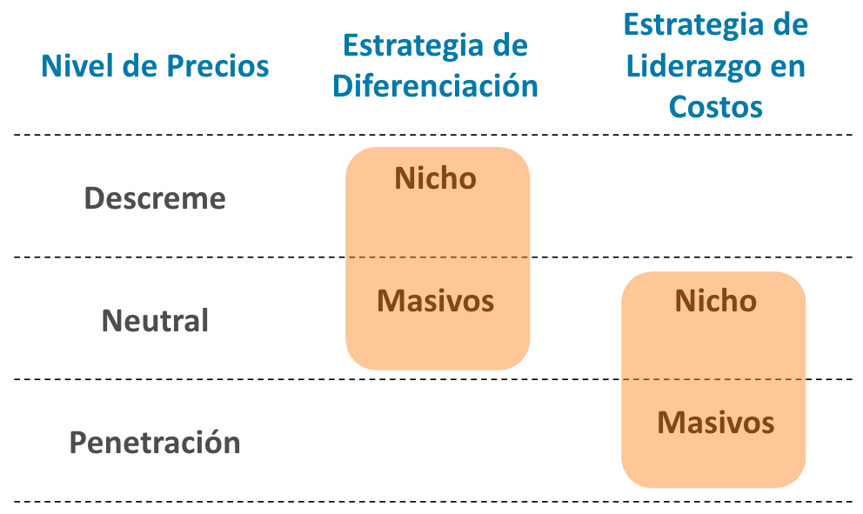
LEVEL OF PRICES
Notes:
For the level of prices, the right path to follow is neutral prices. Neutral prices are fixed based on what an average consumer is willing to pay and considers to be fair.

Slide 20
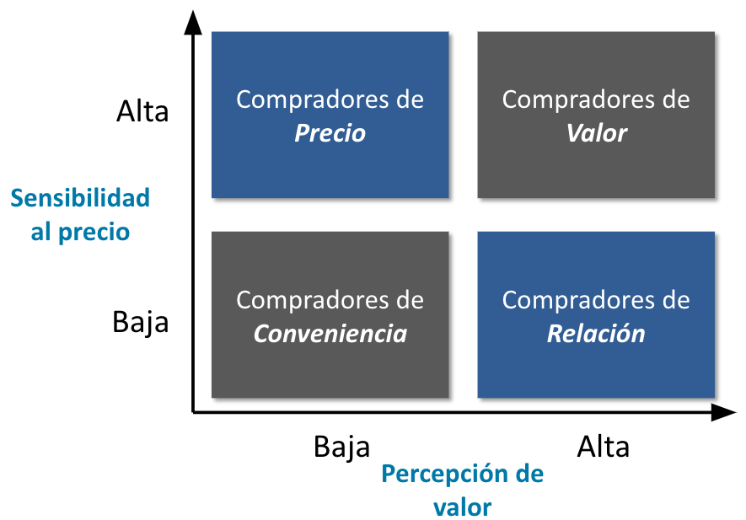
PRICE SENSIBILITY
Notes:
This is aligned with the price sensibility and value perception. Due to covid-19 the demand for products like sanitizer has been on the rise and since they are first need products it does not matter the price, people still going to get them; that is why price sensibility is low and value perception high, so our customers are relationship buyers, meaning you have to create a relationship with them to create loyalty. That is why we are presenting the sanitizer in a different way, in bracelets.

Slide 21
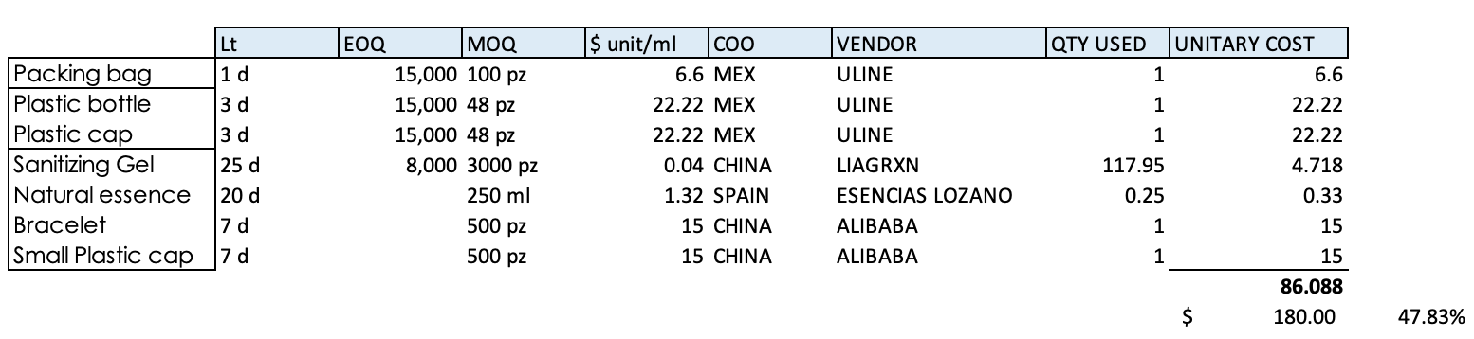
RAW MATERIALS

Slide 22
COSTS AND PRICES
$86.09
$180
47.83%
Cost per unit
Price
Marginal income

Slide 23
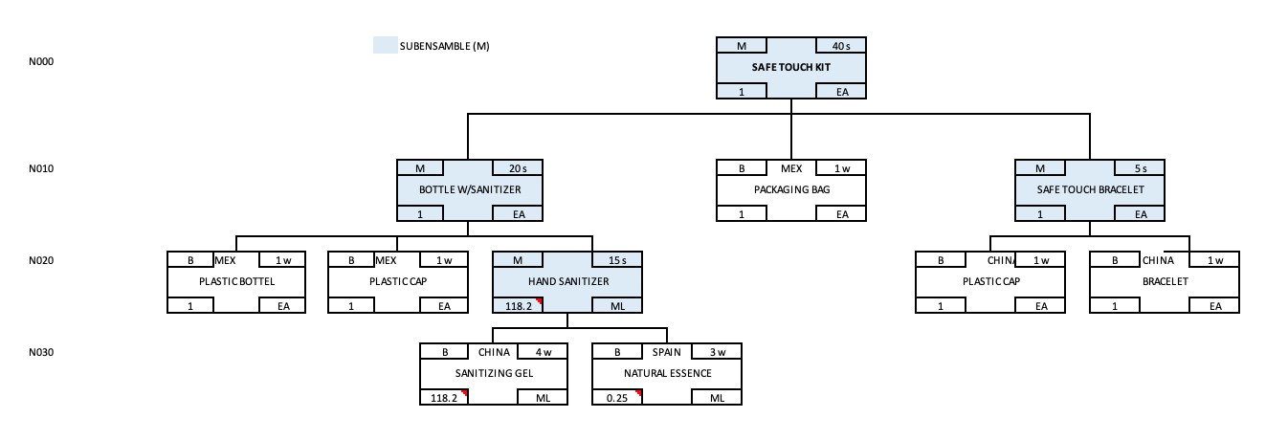
BOM

Slide 24
FORECAST
9.20%
$83
$78
Growth projected for 2021
12,659
Annual production projected for 2021
$2
$93
Assumptions and information obtained from external sources

Slide 25
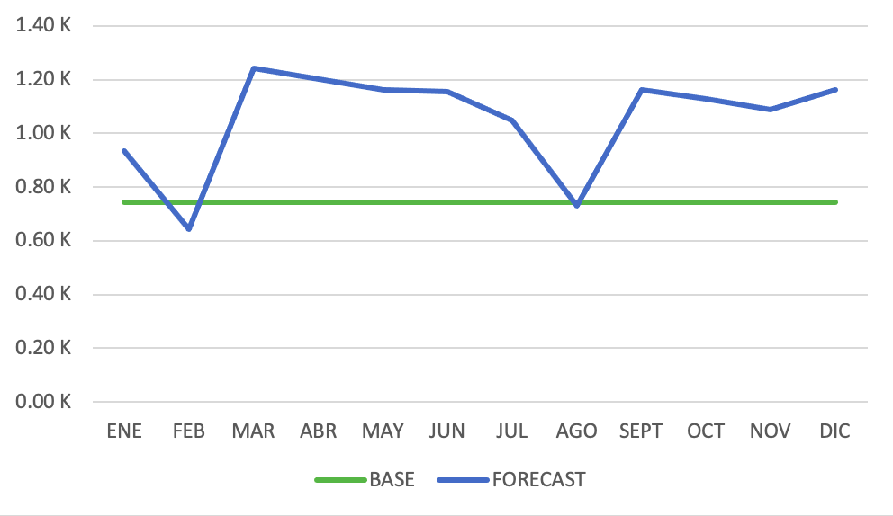
SEASONALITY
Higher sales projected from march to June, and from October to November due to COVID – 19.

Slide 26
LOGISTICS PLAN
AMAZON
INSTAGRAM
65%
35%
We seek to reach our clients massively through the internet.

Slide 27
04
THE STAFF

Slide 28
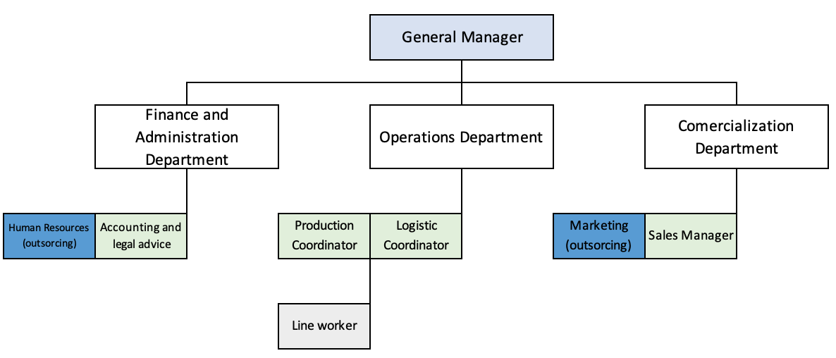
ORGANIZATIONAL PLAN

Slide 29
GENERAL MANAGER
JOB DESCRIPTION
RESPONSIBILITES
- Defines organizational objectives.
- Plans the growth of the company.
- Presents the financial statements, budget and work programs.
- Caring leader and confident decisions maker.
- Helps employees develop.
- Makes sure that our benefits increase.
AUTHORITY
SALARY
The heads of Administration and Finance, Operations and Marketing report to the General Manager.
$20,000

Slide 30
ACCOUNTING AND LEGAL CONSULTANT
JOB DESCRIPTION
RESPONSIBILITES
- Professional in charge of keeping the accounts of the company.
- Measure and analyze the economic situation with the objective of improving the management.
- Review the accounting books of the clients.
- Analyze earnings and expenses.
- Prepare the balance sheet of the financial books, and write reports on the financial status.
AUTHORITY
SALARY
Reports to the head of administration and finance.
$8,000

Slide 31
PRODUCTION COORDINATOR
JOB DESCRIPTION
RESPONSIBILITES
- Participate in the production process.
- Handle specific machinery and tools necessary to get the final product.
- Verify that the quality process in production is adequate.
Supervises the maintenance of production facilities.
Ensures the proper functioning of machinery and equipment,
Supervises the daily performance of each worker in charge of a production process.
AUTHORITY
SALARY
Reports to the Head of Operations.
$8,000

Slide 32
LOGISTICS COORDINATOR
JOB DESCRIPTION
RESPONSIBILITES
- Coordinates units to load in time and form.
- Review cargo documents.
- Coordinates delivery of cargo to destination.
- Generate orders according to production needs
- Coordinate, shipment and orders bought from providers.
AUTHORITY
SALARY
Reports to the Head of Operations.
$8,000

Slide 33
LINE WORKER
JOB DESCRIPTION
RESPONSIBILITES
- Handle the specific machinery and tools necessary to achieve the product transformation.
- Follow step by step the production specifications.
- Programming of operation cycles.
- Disassembly and assembly of machinery.
- Measurement and evaluation of processes.
AUTHORITY
SALARY
Reports to the Production Coordinator.
$5,000

Slide 34
SALES MANAGER
JOB DESCRIPTION
RESPONSIBILITES
- Responsible for maximizing the company's sales.
- Establishes real goals to achieve the increase of the corporation's income.
- Evaluation and development of the marketing strategy and marketing plan.
- Investigation of the demand for the company's products and competition
AUTHORITY
SALARY
Reports to the General Manager.
$10,000

Slide 35
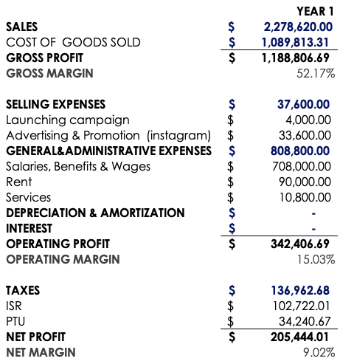
PROFIT AND LOSS STATEMENT
ROI = 0.62

Slide 36
LAUNCH STRATEGY
INSTAGRAM
AMAZON
In Progress
Paid partnerships
Ads
Giveaways
Pop ups
Completed
Get sponsored
Video ads
Not Started
Done

Slide 37
Excel file…

Slide 38
SAFE TOUCH
Is a feasible product
and solution due to
its portability,
practicality, and
futuristic design
being outlined in the
previous
investigation.
Is an alternative born
with fusion of the
actual pandemic
(Covid-19), the customers' needs,
and their fashion
desires.

Slide 39
Thanks!
Please keep this slide for attribution

